Slide 1

BOOTCAMP LECTURE 01
Demystifying AI & Machine Learning
How machines actually learn (and why it isn't magic).

Slide 2
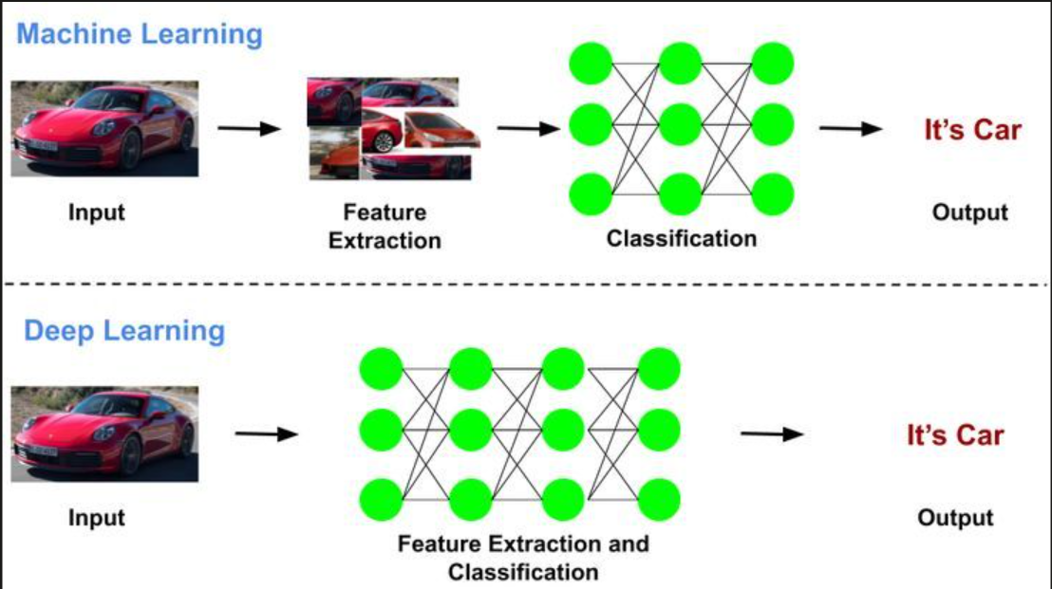
The Big Picture:
AI vs. ML
Artificial Intelligence
The ultimate goal. Machines mimicking human logic and decision-making.
Machine Learning
The actual engine. Algorithms learning patterns directly from data.

Slide 3




How Do We Learn?
Human Learning
Machine Learning
Read books and theories.
Ingest massive datasets.
Take written exams.
Find statistical patterns.
Learn from past mistakes.
Update mathematical weights.

Slide 4



The 3 Flavors of ML
How we train machines dictates what they can do.
Supervised
Unsupervised
Reinforcement
Learning with a teacher and an answer key.
Discovering hidden patterns independently.
Learning through trial, error, and rewards.

Slide 5
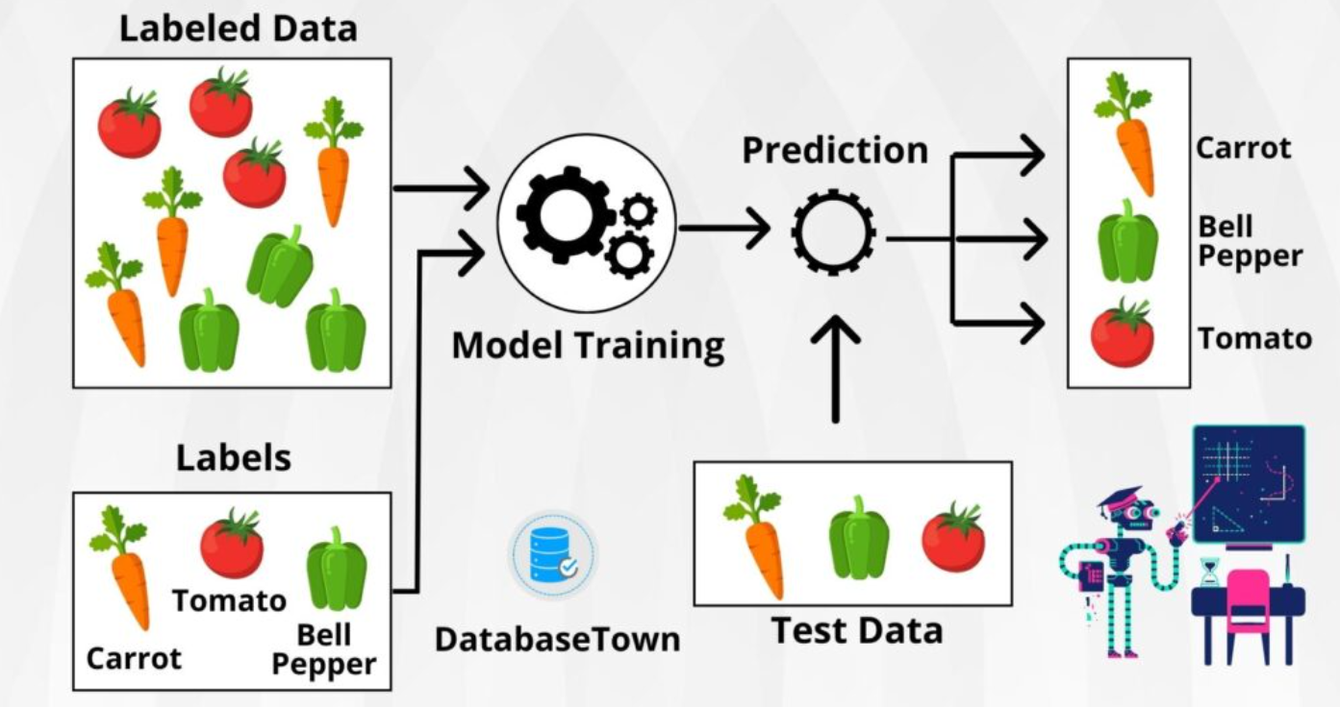
FLAVOR 01
Supervised Learning
1
The machine gets the answers upfront.
Labeled Data: Every input picture has a known output label (e.g., "Cat" or "Dog").
Training Phase: The model memorizes features corresponding to each label.
Ultimate Goal: Accurately predict labels for entirely new, unseen data.

Slide 6


Supervised Learning in Action
Two main types of supervised problems.
Classification
Regression
Is it A or B? (Categorical)
How much? (Continuous Numbers)
Spam vs. Not Spam email.
Predicting house prices.
Benign vs. Malignant tumor.
Forecasting tomorrow's temperature.

Slide 7
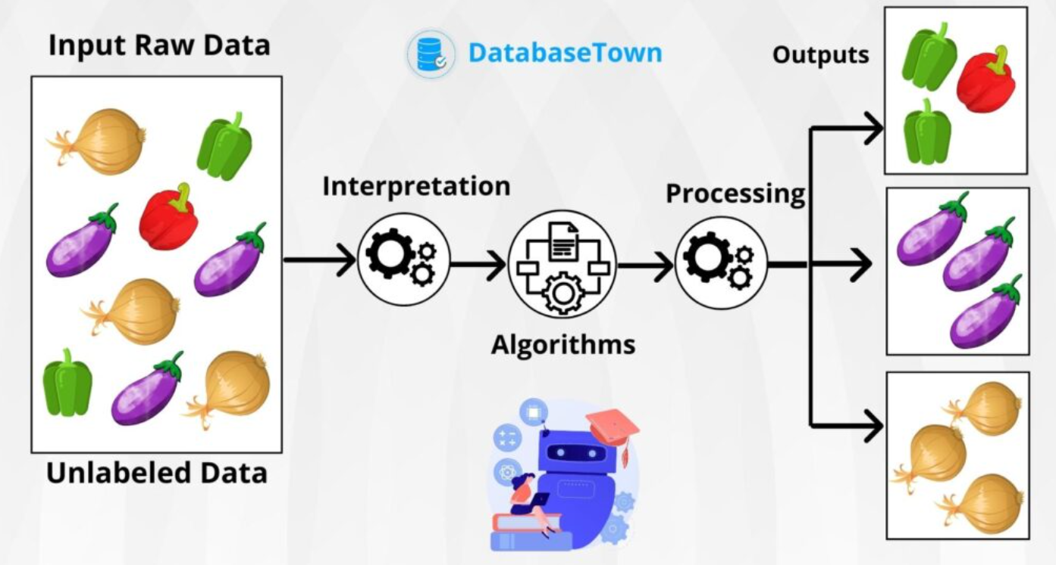
FLAVOR 02
Unsupervised Learning
The machine explores without a map.
Unlabeled Data: A chaotic mess of data with absolutely no correct answers provided.
Discovery Phase: Algorithm groups data points based on underlying similarities.
Ultimate Goal: Find hidden structures, segments, and meaningful clusters.

Slide 8



Real-World Unsupervised ML
Finding patterns you didn't even know existed.
Customer Segmentation
Recommendation Engines
Anomaly Detection
Flagging bizarre credit card transactions as potential fraud.
Grouping shoppers by buying habits to target marketing effectively.
Netflix discovering viewer profiles based on binge-watching history.

Slide 9
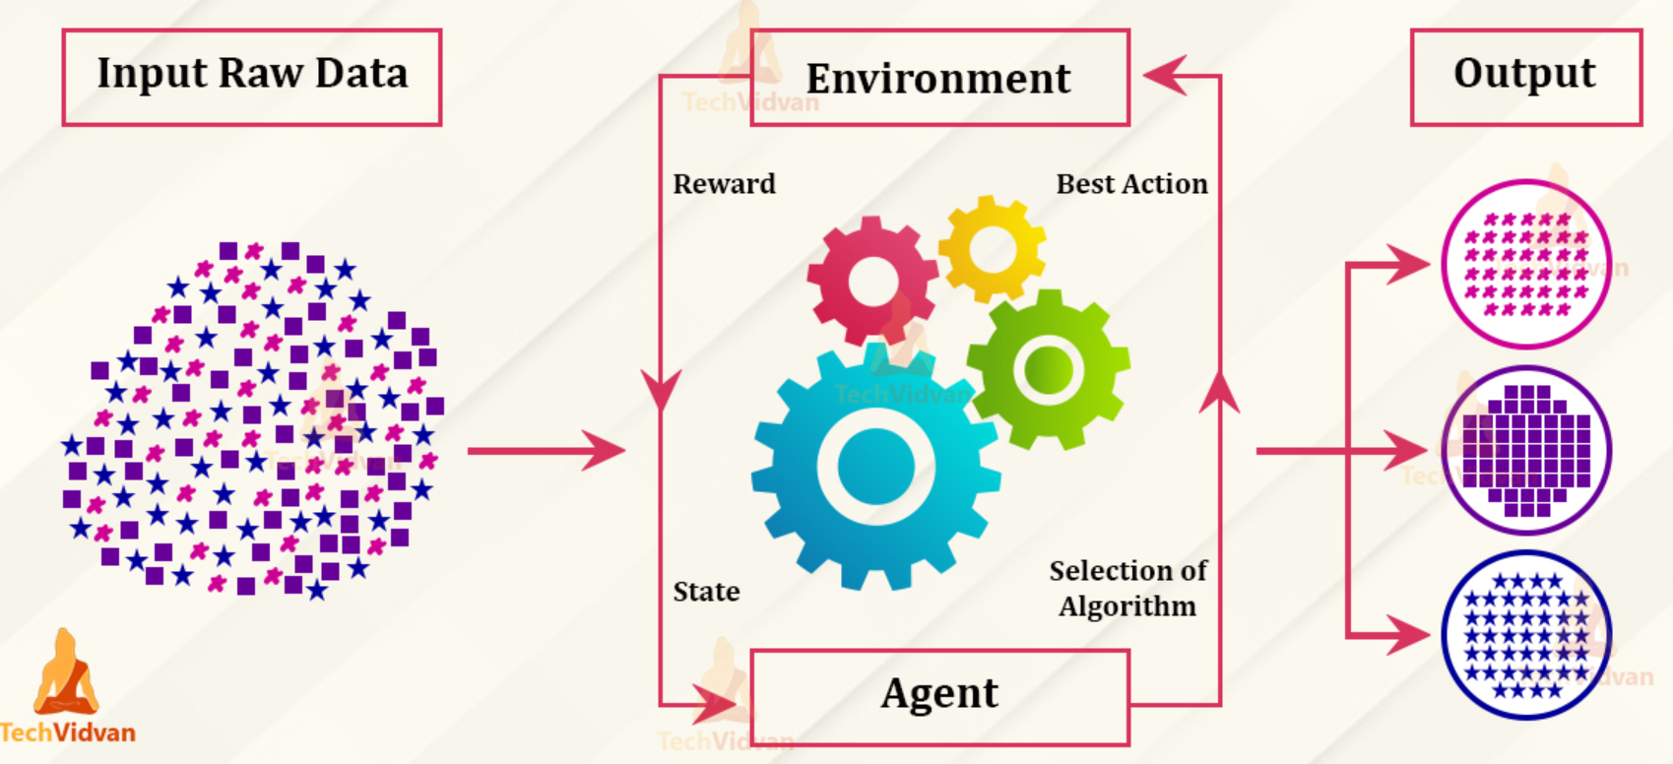
FLAVOR 03
Reinforcement Learning
Trial, error, and chasing high scores.
The Environment: An active space (like a video game or factory floor).
Action & Feedback: The agent makes a move. It gets rewarded (+1) or penalized (-1).
Ultimate Goal: Maximize cumulative reward over time (winning the game).

Slide 10
Pop Quiz! Which Learning Type?
Discuss with your group: Supervised, Unsupervised, or Reinforcement?
SCENARIO A
SCENARIO B
SCENARIO C
Predicting a patient's risk of heart disease based on past medical records and outcomes.
A robot dog teaching itself to walk by trying random leg movements and avoiding falling.
An algorithm grouping millions of Spotify songs into genres based on acoustic similarities.
[ Answer: Supervised ]
[ Answer: Reinforcement ]
[ Answer: Unsupervised ]

Slide 11
Phase 2: Measuring Success
How do we know the machine is actually learning and not just guessing?

Slide 12
Classification Metrics
Evaluating models that sort data into distinct categories (e.g., Malignant vs. Benign).
Core Tools: Confusion Matrices (Mapping True/False positives) & ROC-AUC Curves.
Accuracy
Precision
Recall
F1-Score
Total percentage of correct predictions overall.
Of all predicted positives, how many were actually real?
Of all real positives, how many did we catch? (Crucial for medicine).
The harmonic balance bridging Precision and Recall.

Slide 13


Regression Metrics
Evaluating models that predict continuous numbers (e.g., Hospital Length of Stay).
MAE
MSE
R-Squared
Mean Absolute Error
Mean Squared Error
Coefficient of Determination
The average absolute size of prediction mistakes. Easy to interpret.
Squares errors before averaging. Heavily punishes large outlier mistakes.
Percentage of variance explained by the model. 1.0 is a perfect score.

Slide 14
PHASE 3
The Deep Learning Journey
When data gets too complex for standard algorithms, we need stronger architectures.
Build
Transfer
Distill

Slide 15
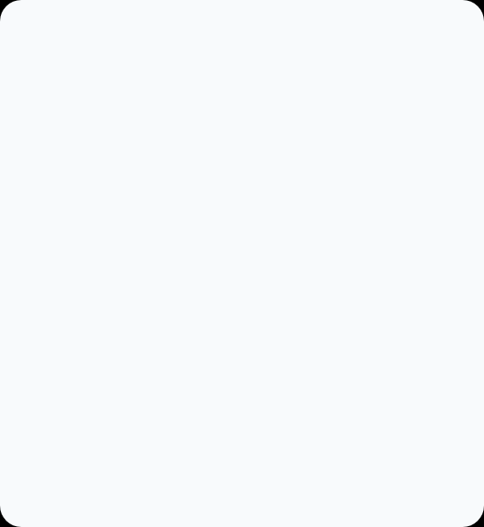
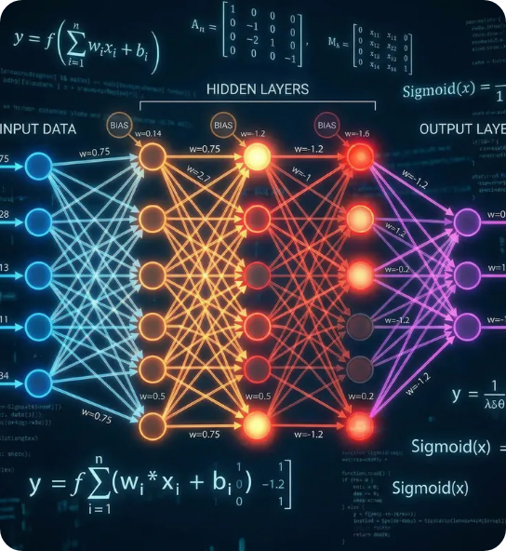

STEP 01: BUILD
Neural Networks
Inspired by the human brain's biology.
Layered Architecture: Input, hidden, and output layers passing signals.
Feature Extraction: Automatically learns complex patterns in unstructured data.

Slide 16



STEP 02: TRANSFER
Transfer Learning
Building from scratch is hard. Repurpose existing intelligence instead.
FINE-TUNING
Pre-Trained Model
Specialized Model
Trained for weeks on millions of generic images (e.g., cats, cars, trees).
Quickly adapted to detect malignant tumors using a small medical dataset.

Slide 17
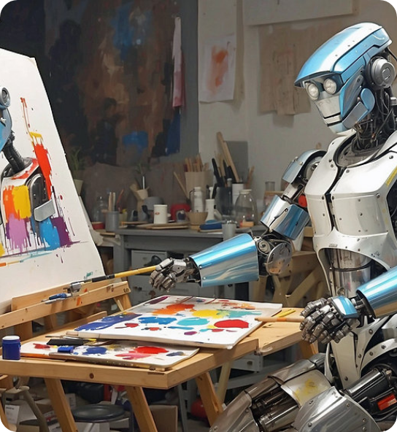
STEP 03: DISTILL
Knowledge Distillation
Passing wisdom from teacher to student.
The Teacher Model
Massive, highly accurate, but extremely slow and expensive to run.
The Student Model
Compact and fast. Learns to mimic the teacher's outputs, retaining accuracy.

Slide 18

You're Now ML Ready.
Questions? Thoughts? Let's dive into your capstone projects.

